Slide 1


Sovereign Bank Data Strategies, Instance Data Replication, Domain Separation
Group 7 - NowArchitect
Architect @ServiceWow
ServiceWow
Notes:
Hello,
My name is Marta Hernández and in this workshop we are going to see three important aspects to take into account before starting to work with ServiceNow

Slide 2
Data Strategies
Instance Data Replication (IDR)
Domain Separation
Key Takeaways
Next Steps
Agenda
Notes:
“Data Strategies”, a set of practices and techniques used to manage, organize, and analyze data within the platform.
“Instance Data Replication” is the process of copying data from one ServiceNow instance to another ServiceNow instance(s). Typically for the purpose of backing up, migrating, or synchronizing data between instance(s). In this section we will look at and analyze this capability as it can be used by “Sovereign Bank”
“Domain Separation”: It is a feature that allows organizations to separate data and processes within a single instance of ServiceNow, allowing for the creation of distinct environments for different business units, departments, or regions. This helps maintain data isolation while allowing for centralized management and configuration within one platform. We will discuss this feature later on whether it is applicable or not for "Sovereign Bank"

Slide 3
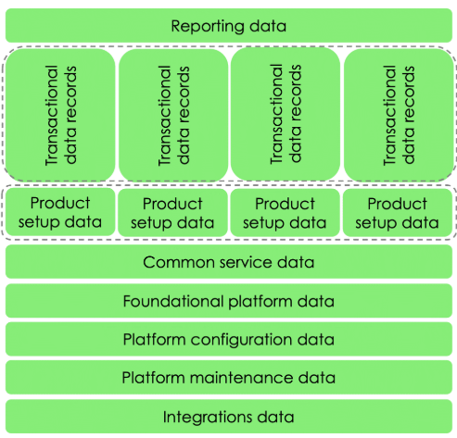
Data Strategies - Data Types
INTEGRATION DATA
IMPORTANT: Identify who owns data using the components of data governance
Notes:
It is important to differentiate the types of data that we are going to manage within SerivceNow (starting from top to bottom)
Reporting data: Performance data created to measure and track KPIs
Transactional data records: Data recorded from transactions on the platform (Incidents, cases…)
Product setup data: Data to configure application functionality or behavior (approvals, notifiaccions…)
Common service data: includes: Service model data, CSDM, CMDB data, including CIs and relationships
Foundation platform data: includes the core business structure and commonly referenced data. (For example: users, groups, and group memberships, companies, business units, and departments, locations, …)
Integrations data:
Integrations data is other data referenced by processes on the platform. It is also imported by integration from external sources.

Slide 4
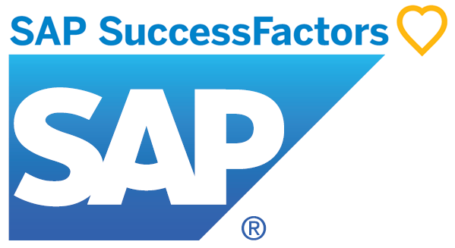
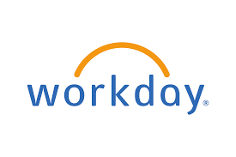

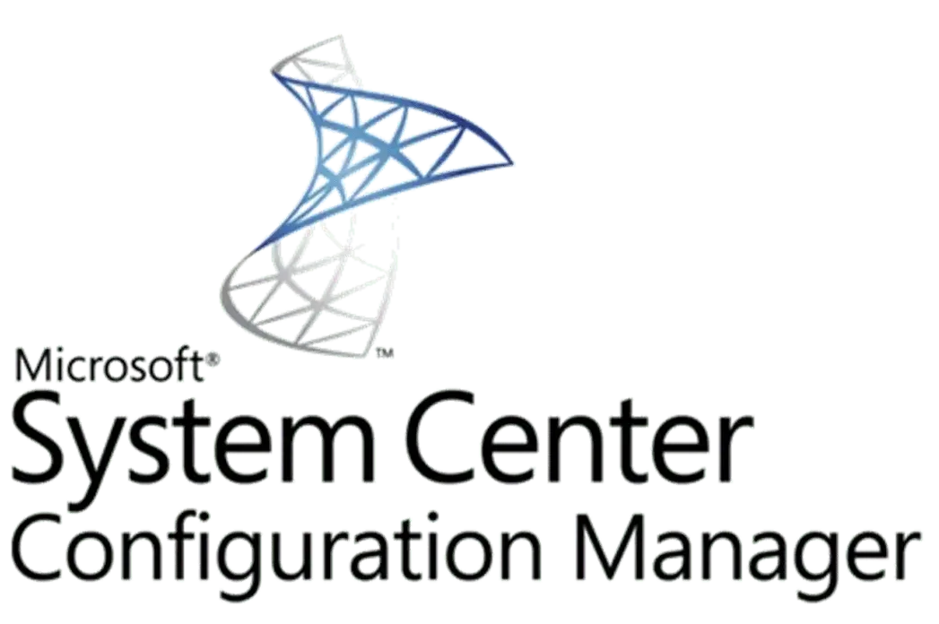
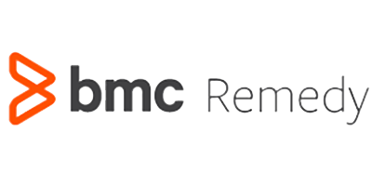
To be Data architecture
Other 3rd party integrations
[via Service Bus (as required)]
Active Directory
Foundation data
User
Groups
Departments
Location
Business Units
EMEA + ASIA
ServiceNow
HR Data
NA
SNC Discovery
Historical data one-time load
CMDB
ITSM (Incident, PRB, CR, KB)
Attachments
Data for CMDB
Notes:
We are considering the following data structure:
First, load the "Foundation Data" from the "Sovereign Bank" Active Directory, where we will import: users, groups, departments, locations and business units, as well as any possible relationships between the different elements (i.e. membership in groups, departments...). This data load will be scheduled every night so as not to overload the system
Second, load the most relevant data from BMC to ServiceNow, among them we have identified CIs, their relationships, ITSM records (incidents, problems, changes, knowledge articles). These data will only be loaded once and at the beginning of the project, to have its history
We must also bring data from the HR applications so that ServiceNow is synchronized with them (SAP in the case of EMA and Asia and WorkDay for users who are from North America)
In the same way that we have the "Foundation data" updated, it is necessary to have the CMDB updated, for this we will use Discovery to discover the CIs as well as their relationships. In addition, we will also use CIs from the "System Center Configuration Manager" and to ensure the data we will use “Identification and Reconciliation Engine (IRE)” API processes three types of inbound quality checks.
Identification rules determine if the new data is for an existing CI, a new CI, or generate a task to let you know something was found but could not be identified.
Reconciliation rules make sure only the most trusted data is used when there are multiple sources of data.
Relationship rules make sure that CIs have the required and appropriate relationships to other CIs in the CMDB.
We will also do these loads on a daily basis and at a time when the performance of the instance is not affected.
Finally, in the event that it is necessary to integrate with internal systems, integrations with third parties will be carried out.

Slide 5
Data Strategies - Strategy
1
Only import data that is needed to support the processes or applications running on ServiceNow.
2
Import data from authoritative systems of record for each data element.
3
Choose automated mechanisms over manual and align import schedules with the latency expectations of dependent processes and expected rate of change in the data.
Notes:
When we are importing data from other systems it is always important to keep these three aspects in mind:
+ Only import data that is needed to support the processes or applications running on ServiceNow.
+ Import data from authoritative systems of record for each data element.
+ Choose automated mechanisms over manual and align import schedules with the latency expectations of dependent processes and expected rate of change in the data.

Slide 6

Data Strategies – Data Security
Encryption
Data Access Control
Security personal data.
Securing asset data
Product-specific data security considerations
Notes:
Data security sets the standards for how customers secure the data created, stored, and/or accessed on the Now Platform.
Identify encryption requirements at your organization and define how you plan to meet them.
Providing record access controls (CRUD) and auditing data
Identify and protect Personally Identifiable Information (PII)
Identify which asset / CI data is considered sensitive, using access controls levels
Consider any application or product specific security requirements, such as ITSM or ITOM

Slide 7
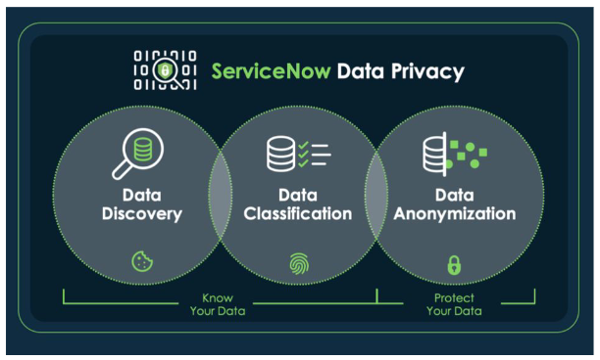
Data Strategies – ServiceNow Data Privacy
ServiceNow Data Privacy provides organizations with the ability to identify sensitive and personal identifiable information (PII) including where it is located using Data Discovery. Once discovery is completed, organizations can use Data Classification to inventory and classify data for responsible use across the organization. Finally, Organizations can protect data by using Data Anonymization ensuring compliance with data privacy laws.
Notes:
Use Data Discovery to identify sensitive data within a ServiceNow instance to classify, protect, or report. Data Discovery runs jobs on a set of tables and reports the information for you to review on the Data Discovery dashboard. A scheduled job automatically uses all active data patterns and target tables when it runs.

Slide 8
Instance Data Replication (IDR)
Instance Data Replication, or IDR allows data synchronization between ServiceNow instances
IDR is capable to do initial loads of data (seeding) and keeping data synchronized continuously (replication) between ServiceNow instance
Advantages of using IDR
1
2
Simple (No – code)
Flexible (Supports a variety of uses cases)
3
4
Reliable (Minimal impact on performance)
Secure (Never leaves ServiceNow datacenters)
Notes:
Instance Data Replication, or IDR allows data synchronization between ServiceNow instances. The instances can be owned by one company who has an IT workflow and an HR Service Delivery instance that requires data to be shared,
Using Instance Data Replication we can:
Copies data updates from one instance to one or more instances
Maintains consistent data across different organizations in the company
Enables one instance to propagate data across different departments and business units to keep data in sync through one-to-many replication
Allows the modifying of data during replication to transform the data as applicable
Advantages of using IDR
Simple (No – code)
Flexible (Supports a variety of uses cases)
Reliable (Minimal impact on performance, IDR uses a Kafka data integration system in the backend.)
Secure (Never leaves ServiceNow datacenters)

Slide 9

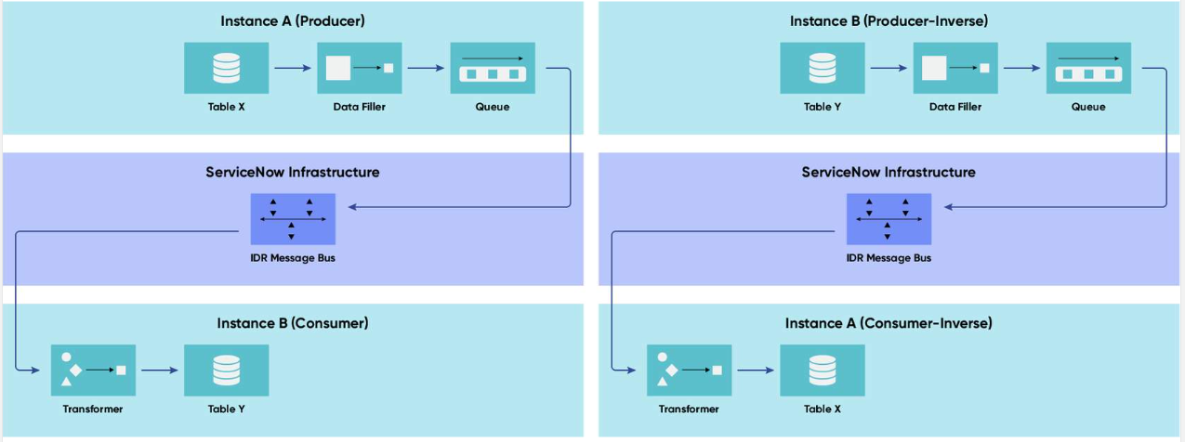
Instance Data Replication (IDR)
Reasons to use both instances
PROD - HR
Separation of Business Functions
Compliance and Data Privacy
Easier Upgrades and Customization
Integration Considerations
PROD – ITSM,
ITOM
Notes:
We propose that "Sovereign Bank" use two production instances, one for HR and one for the rest of the processes, for the following reasons:
Separation of Business Functions These process have distinct processes, workflows, and security requirements. Keeping them in separate instances prevents conflicts and ensures each department can operate independently. Compliance and Data Privacy : HR data includes sensitive personal information (PII) subject to strict regulatory requirements like GDPR and PDPA. A separate HR instance allows for enhanced security, access controls, and compliance measures that may not be necessary for ITSM. Easier Upgrades and Customization : HR and ITSM may have different upgrade schedules and customization needs. Separate instances allow each system to be updated, customized, and managed according to its own roadmap without dependencies. Integration Considerations : HR is already integrated with SAP SuccessFactors and Workday, while ITSM involves IT Operations Management (ITOM), security, and incident management. Having two instances ensures smoother integration without unnecessary entanglement between unrelated systems.
The data to be synchronized is:
+ Foundation data for companies, locations, and users must be shared between instances. At this point we will use a low complexity, indicating the ITSM instance as the data provider, since it is on this instance that the integration with the Active Directory will be configured.
+ The status of CIs/Assets, since HR can assign an asset to a new employee (onboarding phase), and ITSM can assign a new asset to an employee based on a request. At this point we will use a medium complexity since the two instances can be consumers or providers of the data.

Slide 10
Domain Separation - Sovereign Bank
Sovereign Bank needs:
Multi-region data compliance
Historical data consolidation into one platform
Seamless cross-region data replication
Integrate SAP SuccessFactors, Workday, and third-party tools
Domain separation is meant for:
Does This Warrant Domain Separation?
Isolated units with separate data, workflows, and admins
MSPs serving multiple customers in one instance
Sovereign Bank needs-controlled access, not full isolation
Notes:
Sovereign Bank needs:
Multi-region data compliance (GDPR, Privacy Act AU, PDPA APAC, UK data residency).
Consolidation of historical ITSM and customer data into one platform.
Instance data replication strategy for seamless access across regions.
Integration with SAP SuccessFactors, Workday, and third-party tools.
After a long debate, the team of architects have decided: Do not use domain separation
Does This Warrant Domain Separation?
Not really!
Domain separation is meant for:
Managed service providers (MSPs) who serve multiple customers in a single instance.
Highly isolated business units with distinct data, workflows, and admin teams.
Sovereign Bank isn’t an MSP, and their business units need controlled data access, not complete isolation.

Slide 11



Key Takeaways
IMPORTANCE OF DATA GOVERNANCE
SYNCHRONIZING DATA BETWEEN SERVICENOW INSTANCES
DOMAIN STRUCTURE FOR DIFFERENT SERVICE PROVIDERS

Slide 12
Next Steps
Identify the data to be migrated and define the schedule the data import
Define a good data access policy
Encrypt data identified as sensitive data
Define IDR Rules (Process: what and how to sync, Data to sync)

Slide 13




Thank you
www.servicewow-consultancy.com
Notes:
Thank you for your time and attention.
If you have any questions or need us to go into more depth on any of the topics discussed during the session, please do not hesitate to let us know and we will provide more information on it.

